Slide 1
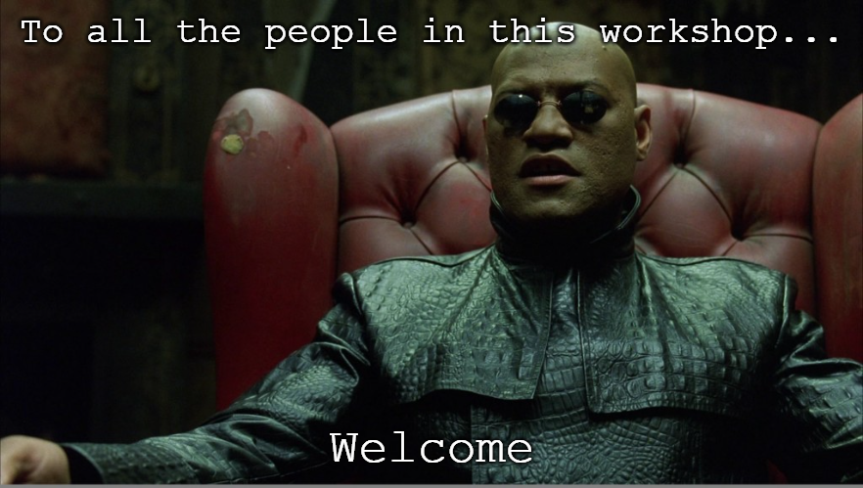

Slide 2
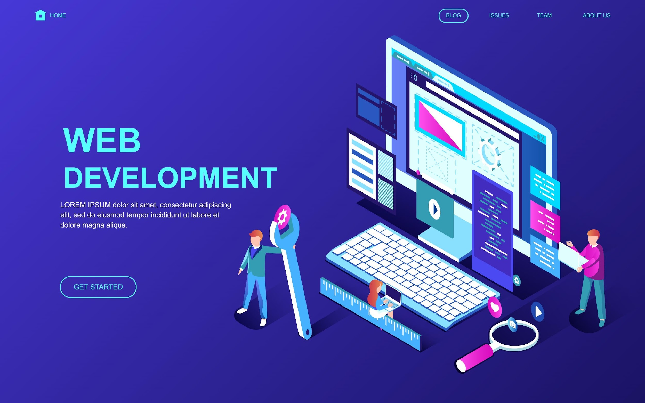

Slide 3
INTRODUCITON TO WEBSITES
A website is a collection of web pages which are build using HTML, CSS and JavaScript
HTML (Hyper Text Markup Language): HTML is the code that is used to structure a web page and its content
CSS (Cascading Style Sheet): CSS is used to add style to a web page by dictating how a site is displayed on a browser. CSS is responsible for the text style, size, positioning, color, and more on a website. It’s also what controls how a website’s style shifts between desktop and mobile versions. Without CSS, websites would look pretty boring.
JavaScript: JavaScript is a text-based programming language used both on the client-side and server-side that allows you to make web pages interactive. Where HTML and CSS are languages that give structure and style to web pages, JavaScript gives web pages interactive elements that engage a user.

Slide 4
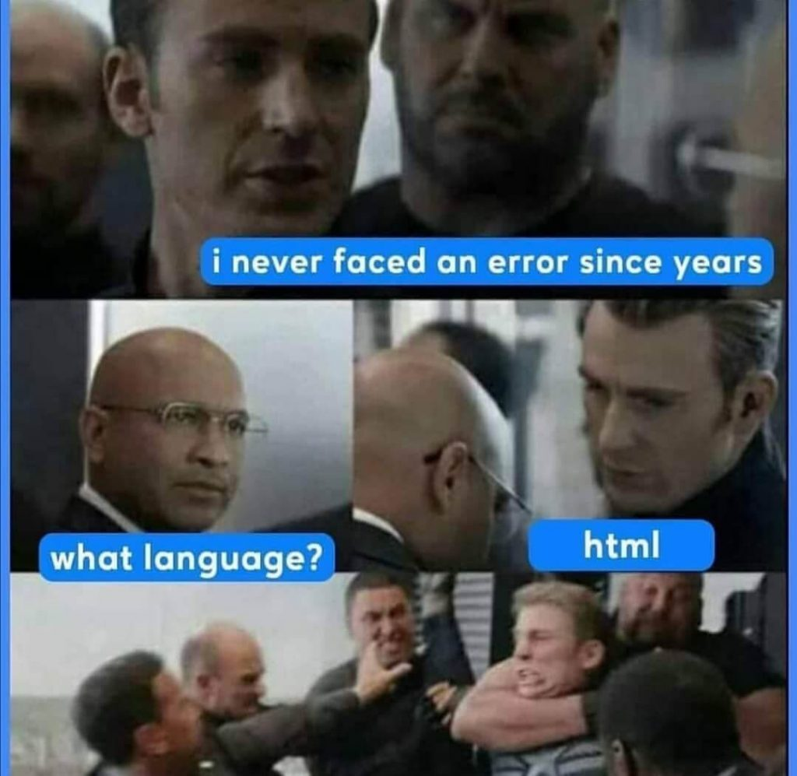

Slide 5
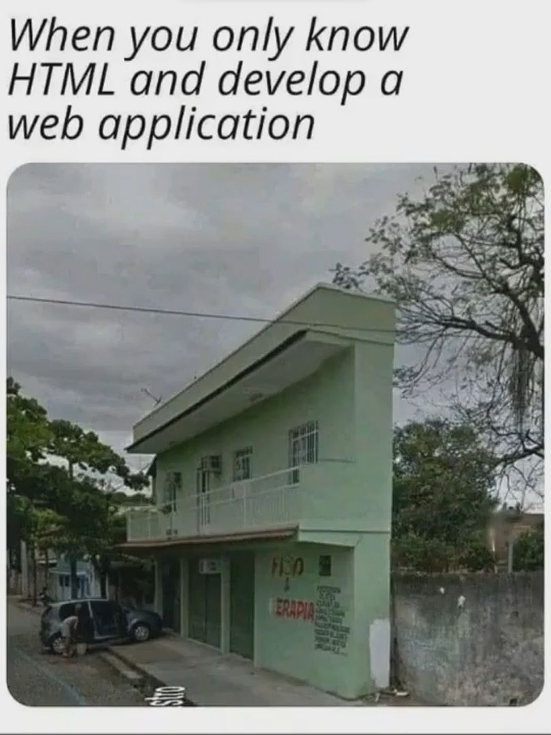

Slide 6
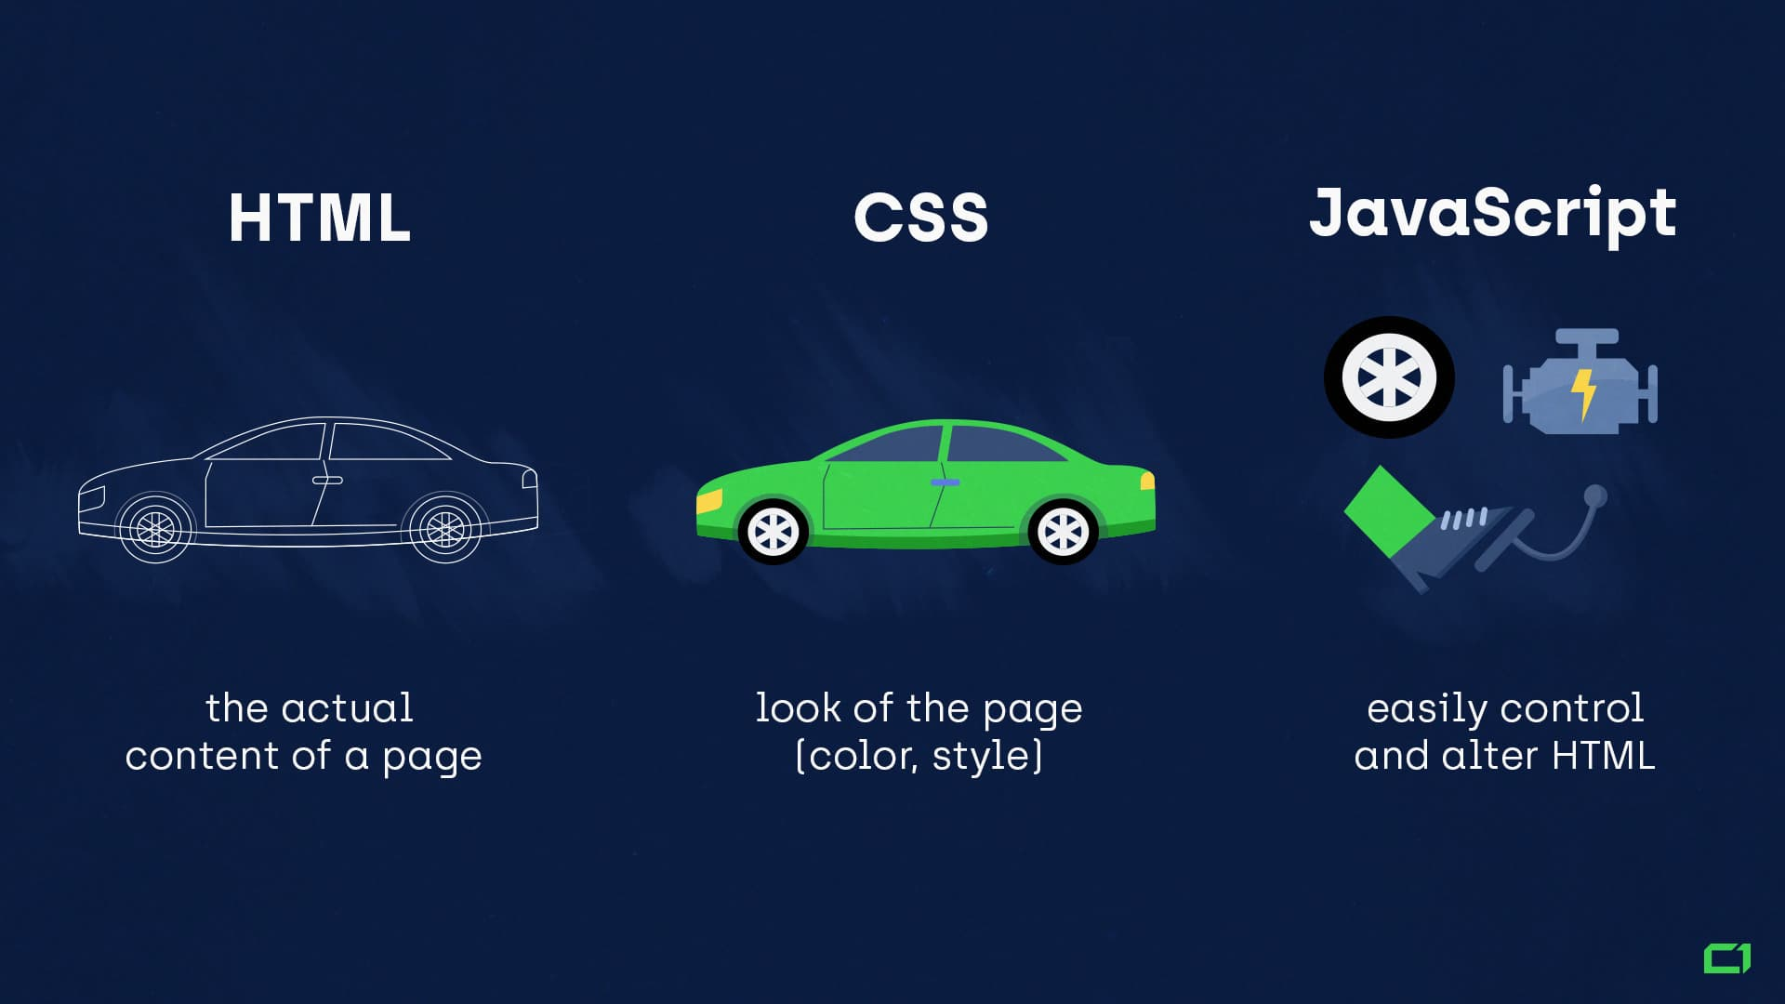

Slide 7
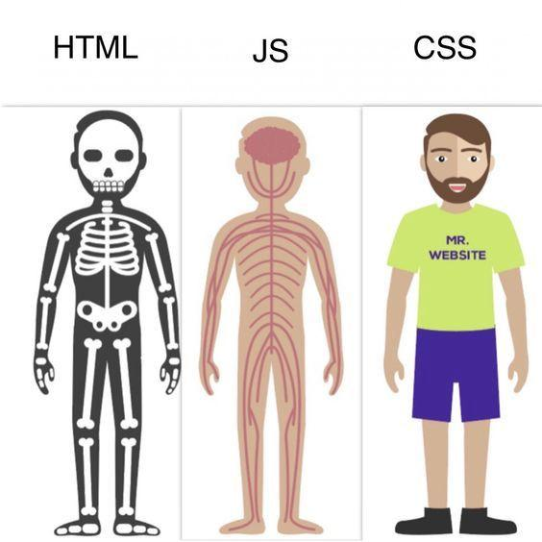

Slide 8
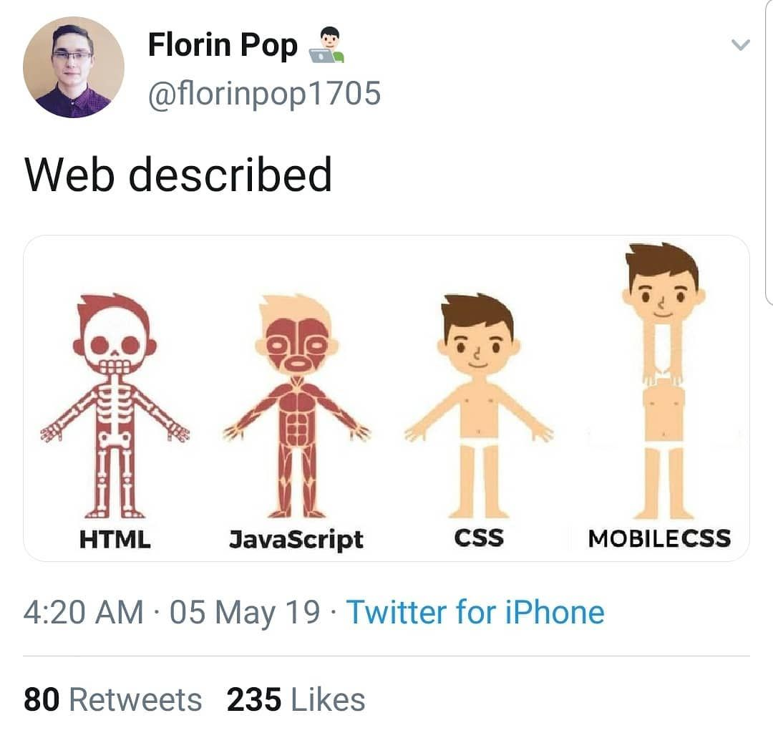

Slide 9
Web Terminologies
HTML (Hyper Text Markup Language) - the "programming" language used to write web pages
Source file - the set of tags and text which make up a web page. Browsers process the source file to make the web page look the way the designer wanted it to look.
URL (Uniform Resource Locator) - a web address; indicates the location of a web resource as well as the protocol needed to access it
Protocol - ground rules or "language" that internet computers use to "talk" with each other

Slide 10
HTTP (Hyper Text Transfer Protocol) - the internet protocol which allows web pages to work
FTP (File Transfer Protocol) - allows computers to exchange files over a network
Web page - a single page on the web (a "homepage" is the first web page on a web site)
Web site - a collection of web pages, usually on a particular topic or business
Web browser/navigator/client - the software application which displays web pages
Web server - the computer or network of computers which stores web pages

Slide 11
What is Web Development?
Web development refers to the creating, building, and maintaining of websites.
It includes aspects such as web design, web publishing, web programming, and database management. It is the creation of an application that works over the internet i.e. websites.
Web development is classified into 3 types
Frontend Development
Backend Development
Full-stack Development
Those builds/develop website is known as Web Developer Or Web Dev

Slide 12


Slide 13


Slide 14
Client Server Architecture
Client server architecture is a computing model in which the server hosts, delivers, and manages most of the resources and services requested by the client. It is also known as the networking computing model or client server network as all requests and services are delivered over a network. The client-server architecture or model has other systems connected over a network where resources are shared among the different computers.
Typically, client server architecture is arranged in a way that clients are often situated at workstations or on personal computers, while servers are located elsewhere on the network, usually on more powerful machines. Such a model is especially beneficial when the clients and server perform routine tasks. For example, in hospital data processing, a client computer can be busy running an application program for entering patient information, meanwhile the server computer can be running another program to fetch and manage the database in which the information is permanently stored.

Slide 15
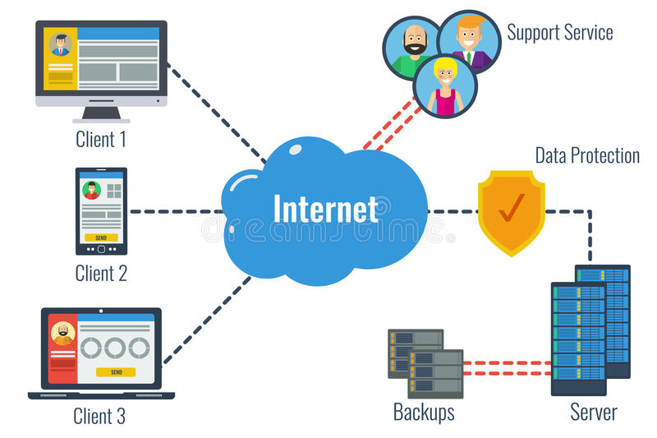

Slide 16
How does client server architecture work?
The user enters the uniform resource locator (URL) of the website or file and the browser sends a request to the domain name system (DNS) server.
The DNS server looks for the address of the web server and the DNS server responds with the IP address of the web server.
After the DNS server responds, the browser sends over an HTTP or HTTPS request to the web server’s IP, which was provided by the DNS server.
The server then sends over the necessary files of the website.
Finally, the browser renders the files and the website is displayed.

Slide 17


Slide 18
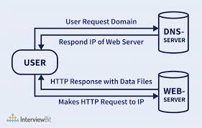

Slide 19
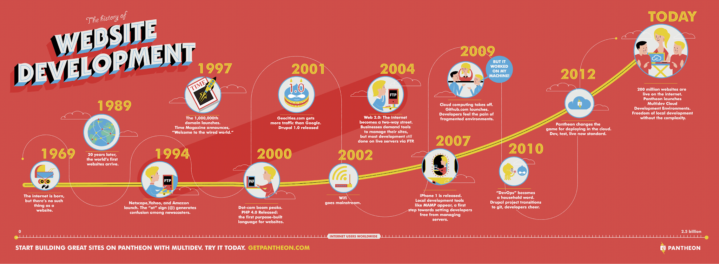

Slide 20
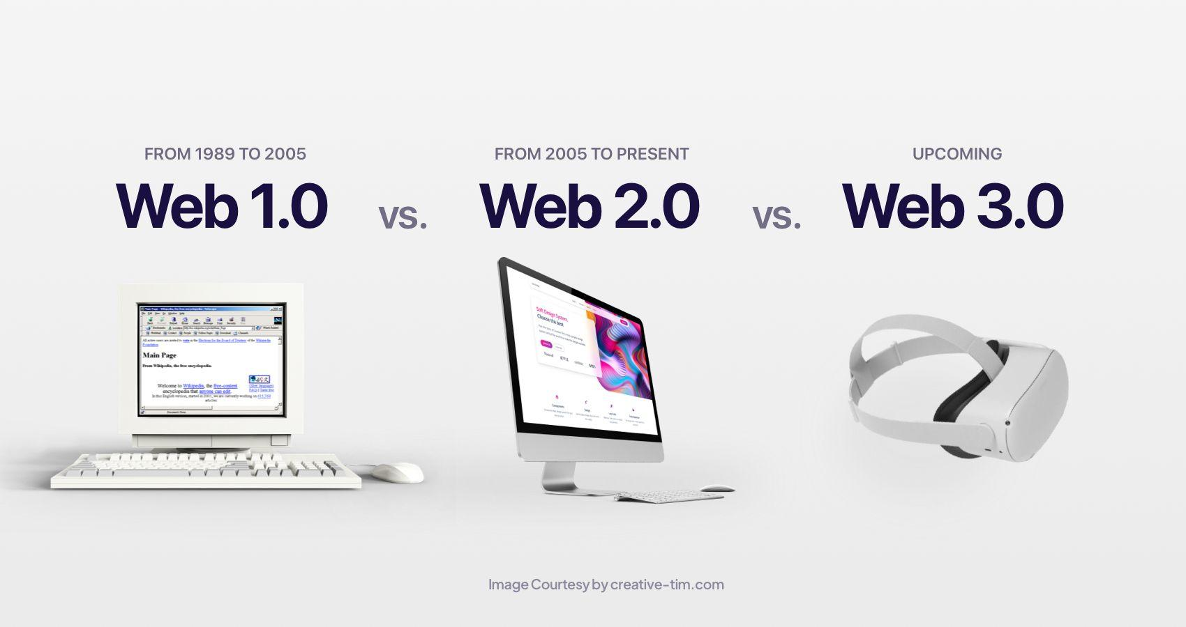

Slide 21
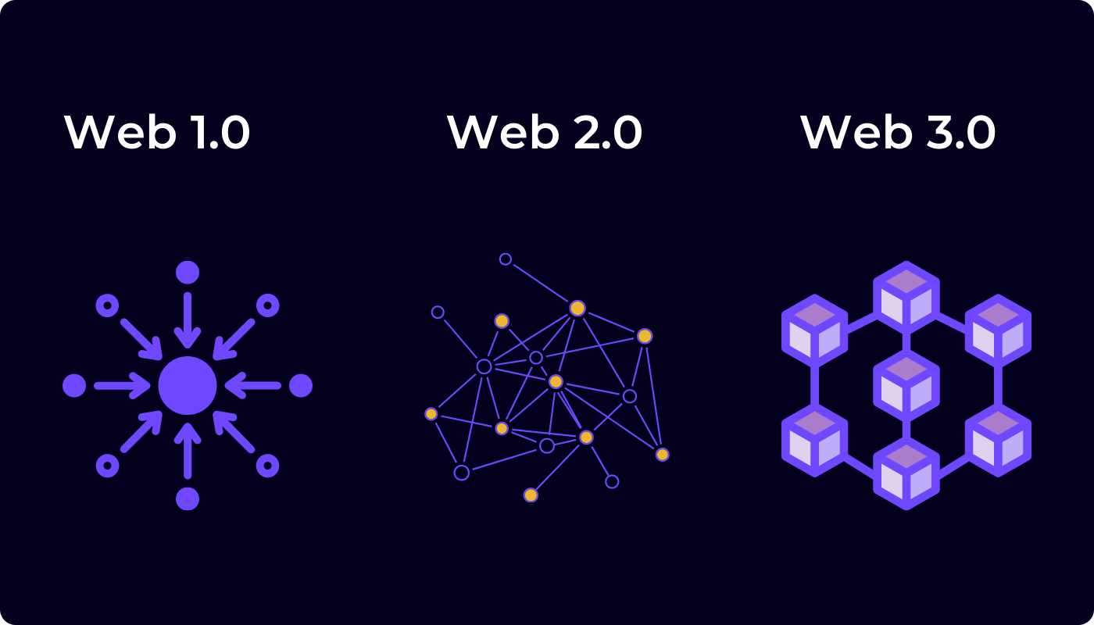

Slide 22
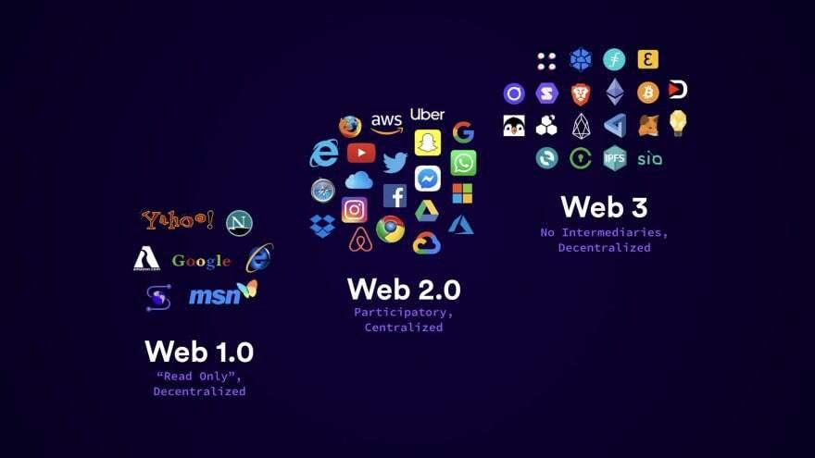

Slide 23
Web 1.0 vs Web 2.0 vs Web 3.0
Web 1.0: Web 1.0 was all about fetching, and reading information. These websites are also knowns as static websites which means websites that is not interactive
Web 2.0: Web 2.0 is all about reading, writing, creating, and interacting with the end user. It was famously called the participative social web. These websites uses JavaScript to make the website interactive to end user
Web 3.0: Web 3.0 is the third generation of the World Wide Web, and is a vision of a decentralized web which is currently a work in progress. It is all about reading, writing, and owning. These websites are decentralized and the securest generation of the Web. The technologies used in web 3 are Blockchain, Artificial Intelligence, Decentralization, Cryptocurrency

Slide 24

WEB HOSTING

Slide 25
What is web hosting?
Web hosting refers to a service that puts your website on the internet. In other words, it make available to your users to be viewed any time.
There are two different types of hosting :-
Host the website yourself
Find a hosting provider to host your website

Slide 26
Hosting yourself
Hosting the website yourself means that you will need to have the right equipment, including a web server (basically a computer) and 24/7 internet access.
You’ll have absolute control of the website.
You have ull transparency.
there are no restrictions what you can upload
Hosting a website yourself is risky.
Cyber attacks can happens and compromise your network security.
Running a server 24/7 is pretty expensive.

Slide 27
Hosting Provider
This is the most common choice for web hosting. Using a third party hosting provider allows you to concentrate on developing your website.
24/7 customer support.
FTP is used to update the website info in real time.
Coverage all over the world.
You don’t full control of the website.
Have forced limitation(ex: no. of requests) for different tiers.
Examples :- AWS, AZURE, firebase, heroku, replit, github.

Slide 28
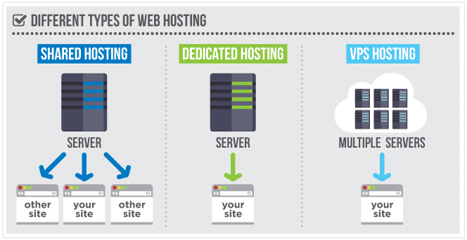

Slide 29
Configuring Domain Name
To get started we should get a domain name. there are many domain registrars(Namecheap, google domains, domain.com, etc) to buy domains. General simple domains are costly.
To set your domain name of our website you need to go to the domain registrars and configure in the setting of the bought domain with the ip address of the server. This help the DNS server to locate the IP address.

Slide 30
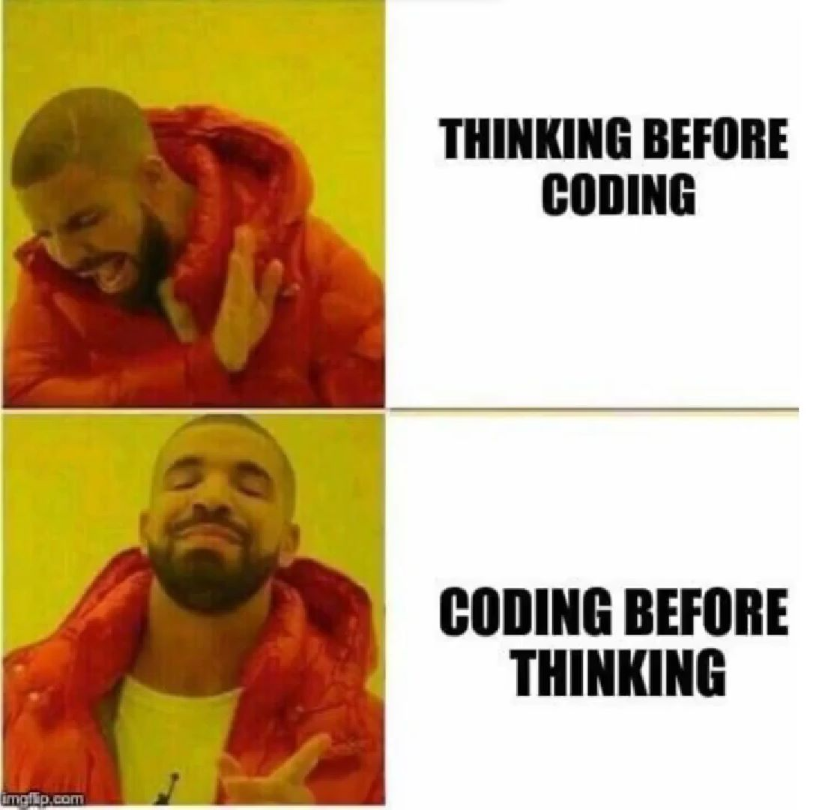

Slide 31


Slide 32


Slide 33


Slide 34


Slide 35
